Slide 1
SINGLE-SOURCE SHORTEST PATHS Shortest Path is DAGs

Slide 2
Shortest Path Problems
Directed weighted graph.
Path length is sum of weights of edges on path.
The vertex at which the path begins is the source vertex.
The vertex at which the path ends is the destination vertex.
t
x
3
6
9
3
4
s
0
2
1
2
7
5
3
5
11
6
y
z

Slide 3
Example
Consider Source node 1 and destination node 7
A direct path between Nodes 1 and 7 will cost 14

Slide 4
Example
A shorter path will cost only 11

Slide 5
Shortest-Path Variants
Single-source single-destination (1-1): Find the shortest path from source s to destination v.
Single-source all-destination(1-Many): Find the shortest path from s to each vertex v.
Single-destination shortest-paths (Many-1): Find a shortest path to a given destination vertex t from each vertex v.
All-pairs shortest-paths problem (Many-Many): Find a shortest path from u to v for every pair of vertices u and v.

Slide 6

Shortest-Path Variants
No need to consider different solution or algorithm for each variant
(we reduce it into two types)
Single-source single-destination (1-1): Find the shortest path from source s to destination v.
Single-source all-destination(1-Many): Find the shortest path from s to each vertex v.
Single-destination shortest-paths (Many-1): Find a shortest path to a given destination vertex t from each vertex v.
All-pairs shortest-paths problem (Many-Many): Find a shortest path from u to v for every pair of vertices u and v.

Slide 7
Shortest-Path Variants
Single-Source Single-Destination (1-1) No good solution that beats 1-M variant Thus, this problem is mapped to the 1-M variant | Single-Source All-Destination (1-M) Need to be solved (several algorithms) We will study this one
All-Sources Single-Destination (M-1) Reverse all edges in the graph Thus, it is mapped to the (1-M) variant | All-Sources All-Destinations (M-M) Need to be solved (several algorithms) We will study it (if time permits)

Slide 8
Shortest-Path Variants
Single-Source Single-Destination (1-1) No good solution that beats 1-M variant Thus, this problem is mapped to the 1-M variant | Single-Source All-Destination (1-M) Need to be solved (several algorithms)
All-Sources Single-Destination (M-1) Reverse all edges in the graph Thus, it is mapped to the (1-M) variant | All-Sources All-Destinations (M-M) Need to be solved (several algorithms)

Slide 9
Shortest-path problems
Single-source shortest path algorithms
Bellman-Ford algorithm
Dijkstra algorithm
All-Pair shortest path algorithms
Floyd-Warshall algorithm

Slide 10
Introduction
Generalization of BFS to handle weighted graphs
Direct Graph G = ( V, E ), edge weight fn ; w : E → R
In BFS w(e)=1 for all e Î E
Weight of path p = v₁ → v₂ → … → v_{k} is

Slide 11
Shortest Path
Shortest Path = Path of minimum weight
δ(u,v)=
p
min{ω(p) : u v}; if there is a path from u to v,
∞ otherwise.

Slide 12
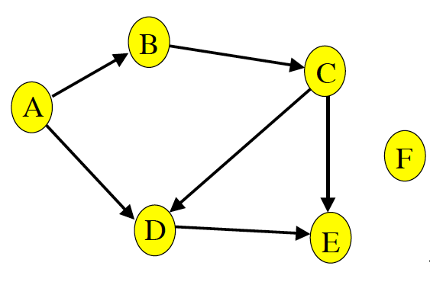
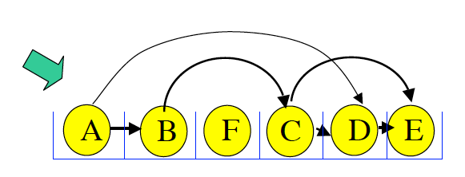
Key Property in DAGs
If there are no cycles ➔ it is called a DAG
In DAGs, nodes can be sorted in a linear order such that all edges are forward edges
Topological sort

Slide 13
Single-Source Shortest Paths in DAGs
Shortest paths are always well-defined in dags
no cycles => no negative-weight cycles even if there are negative-weight edges
Idea: If we were lucky
To process vertices on each shortest path from left to right, we would be done in 1 pass

Slide 14
Single-Source Shortest Paths in DAGs
DAG-SHORTEST PATHS(G, s)
TOPOLOGICALLY-SORT the vertices of G
INIT(G, s)
for each vertex u taken in topologically sorted order do
for each v in Adj[u] do
RELAX(u, v)

Slide 15



Observation 1
If there is no cycle (DAG), ...
Relax in topological order.
s
v1
vj
vi
Θ(m)
v

Slide 16
Example
6
1
r
s
t
u
v
w
∞
5
0
2
∞
7
∞
–1
∞
–2
∞
4
3
2

Slide 17
Example
6
1
r
s
t
u
v
w
∞
5
0
2
∞
7
∞
–1
∞
–2
∞
4
3
2

Slide 18
Example
6
1
r
s
t
u
v
w
∞
5
0
2
2
7
6
–1
∞
–2
∞
4
3
2

Slide 19
Example
6
1
r
s
t
u
v
w
∞
5
0
2
2
7
6
–1
6
–2
4
4
3
2

Slide 20
Example
6
1
r
s
t
u
v
w
∞
5
0
2
2
7
6
–1
5
–2
4
4
3
2

Slide 21
Example
6
1
r
s
t
u
v
w
∞
5
0
2
2
7
6
–1
5
–2
3
4
3
2

Slide 22
Example
6
1
r
s
t
u
v
w
∞
5
0
2
2
7
6
–1
5
–2
3
4
3
2

Slide 23
Single-Source Shortest Paths in DAGs: Analysis
O(V+E)
DAG-SHORTEST PATHS(G, s)
TOPOLOGICALLY-SORT the vertices of G
INIT(G, s)
for each vertex u taken in topologically sorted order do
for each v in Adj[u] do
RELAX(u, v)
O(V)
Total O(E)
Time Complexity: O (V + E)

Slide 24
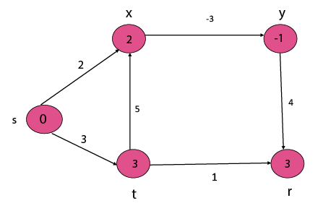
Single Source Shortest Path in a directed Acyclic Graphs-Example

Slide 25
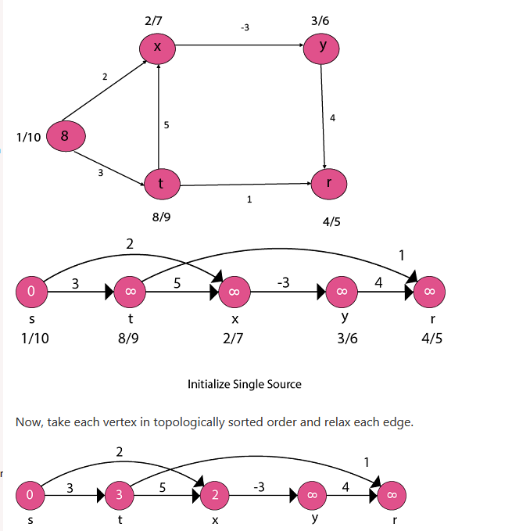
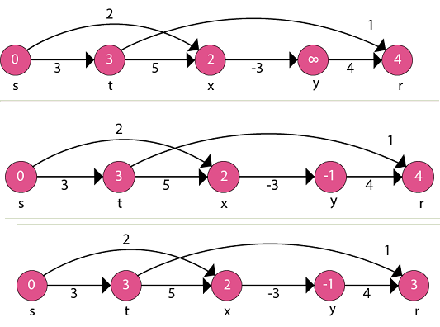

Slide 26
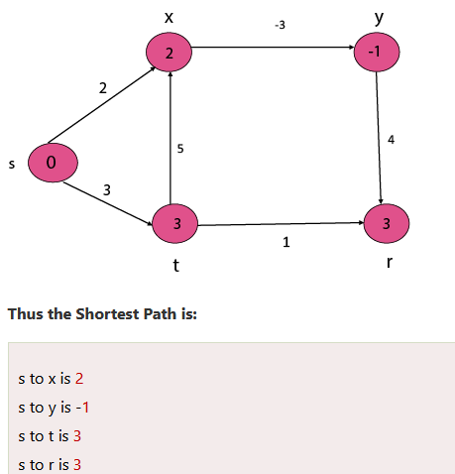

Slide 27
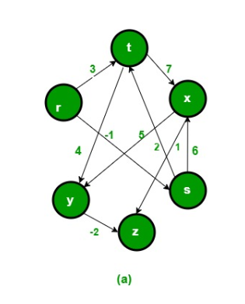
Example

Slide 28
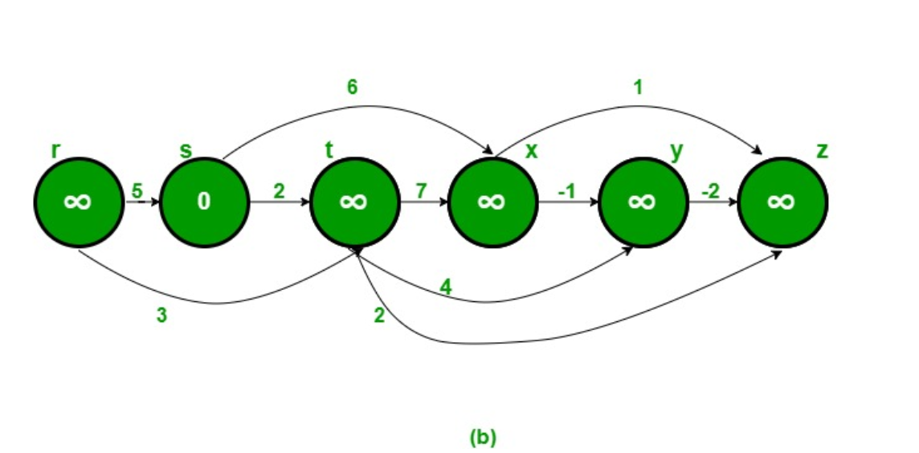

Slide 29
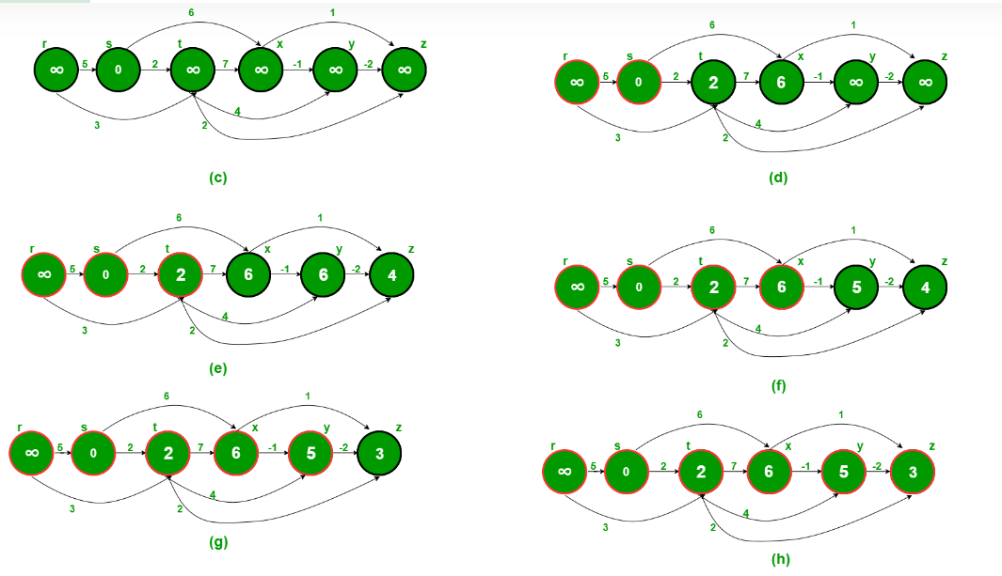

Slide 30
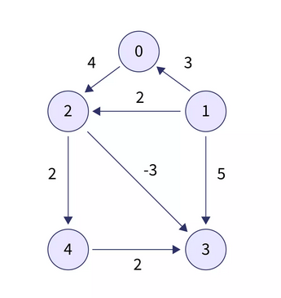
Example
Consider the below given Directed acyclic graph and let's say we need to find the shortest distance of all vertices from vertex 0.

Slide 31
Topological sorting
Topological sorting of this graph is:
[1, 0, 2, 4, 3]

Slide 32
Example
dist = [0, INF, INF, INF, INF]
Now we will create an array dist of size V (here V=5) all entries of which will be initialized with INF. Then assign dist[start]=0.
dist = [0, INF, INF, INF, INF]
topo[0]=1 The adjacent vertices of 1 are 0, 2, and 3.
topo[1]=0 The adjacent vertex of 0 is 2.
dist = [0, INF, 4, INF, INF]
topo[2]=2 The adjacent vertices of 2 are 3 and 4.
dist = [0, INF, 4, 1, 6]
topo[3]=4 The adjacent vertex of 4 is 3.
topo[4]=3 There are no adjancet vertices to 3 hence we will not do anything
Finally the dist array will be dist=[0, INF, 4, 1 ,6].

Slide 33
Complexity Analysis
Time Complexity - For a graph G=(V,E) time taken to find the topological ordering is O(V+E).
After that, for every vertex Vi​ we run a loop to its adjacent vertices. So time taken in this step is also O(V+E). Hence the overall time complexity is O(V+E).
Space Complexity - We are using a visited array of size V and Stack which will be of size V, so the overall space complexity is O(V).

Slide 34
Conclusion
In the case of the Directed Acyclic Graphs (DAG), finding the topological ordering of the vertices can help us to find the single source shortest paths in O(V+E) time.
Unlike the Bellman Ford algorithm which takes O(V×E) time to calculate the same.
Application: Shortest path algorithm helps to find the nearest location such as restaurants, hotels in maps.

Slide 35
References
https://www.scaler.com/topics/data-structures/prims-algorithm/
https://www.geeksforgeeks.org/directed-acyclic-graph-in-compiler-design-with-examples/
https://www.scaler.com/topics/data-structures/kruskal-algorithm/

